Slide 1
DERIVATION TREE CONTEXT FREE GRAMMAR
PERTEMUAN 7

Slide 2
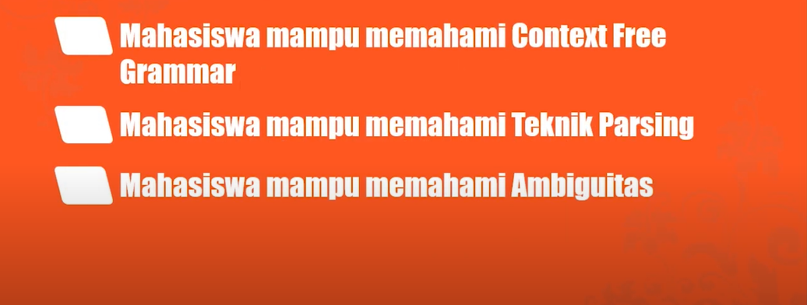
INDIKATOR

Slide 3
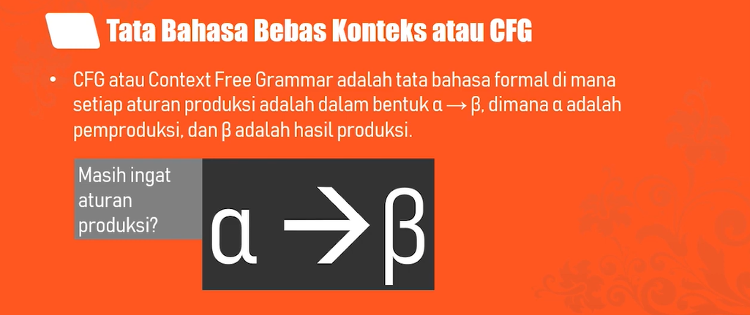
CONTEXT FREE GRAMMAR

Slide 4
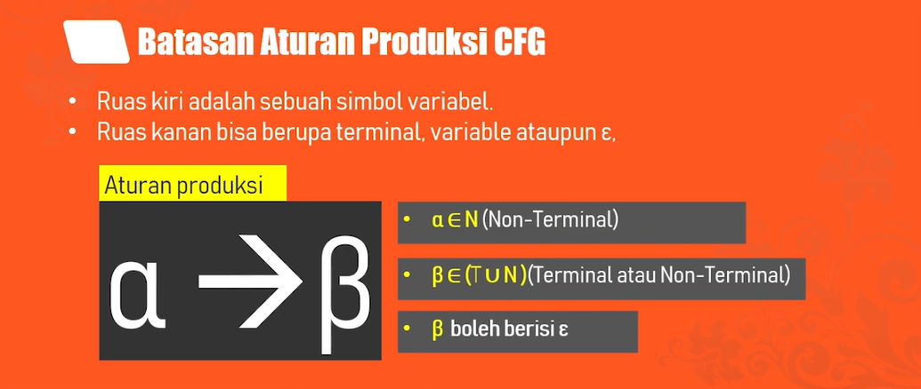
CONTEXT FREE GRAMMAR

Slide 5
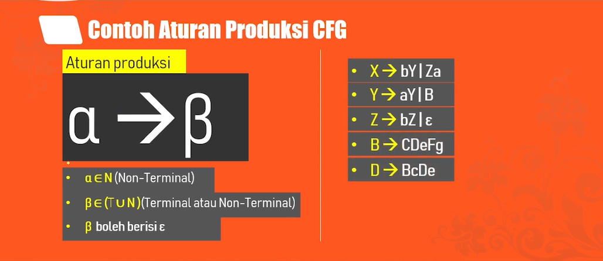
CONTEXT FREE GRAMMAR

Slide 6
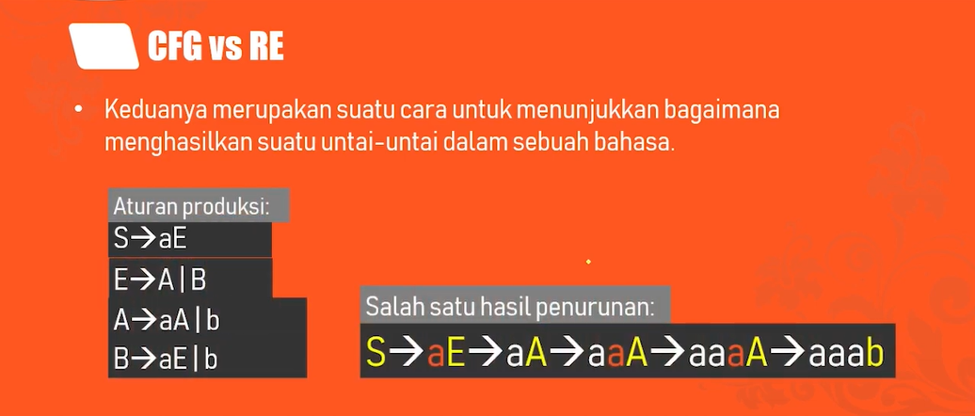
CONTEXT FREE GRAMMAR

Slide 7
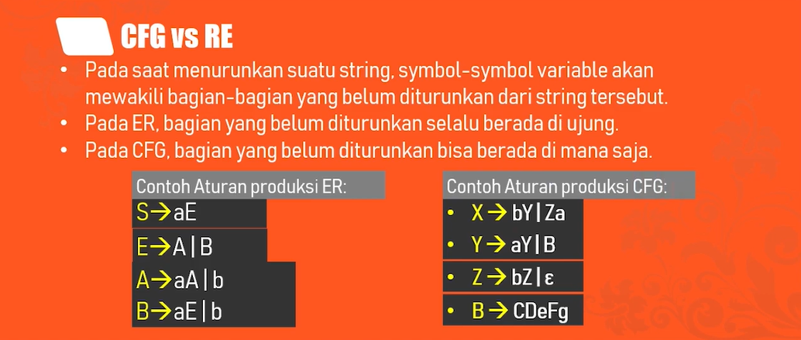
CONTEXT FREE GRAMMAR
ER dikanan

Slide 8
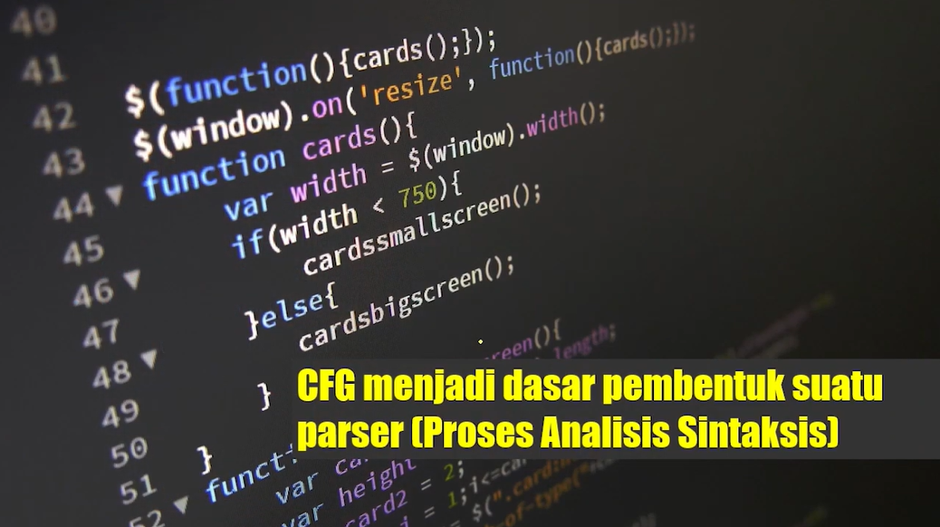

Slide 9
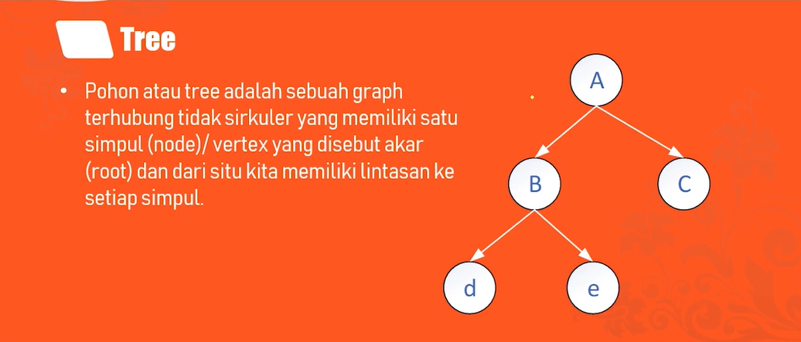
PARSING

Slide 10
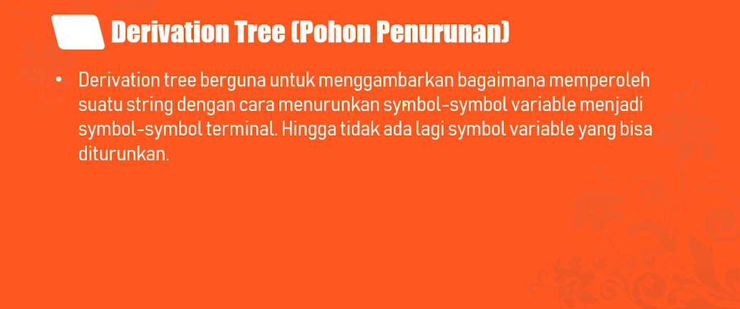
PARSING

Slide 11
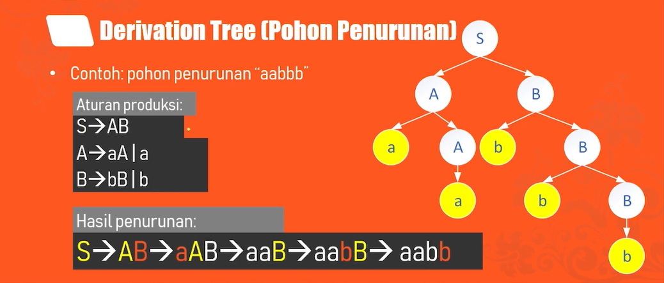
PARSING
S→ AB → aAB→aaB→aabB→aabbB→ aabbb

Slide 12
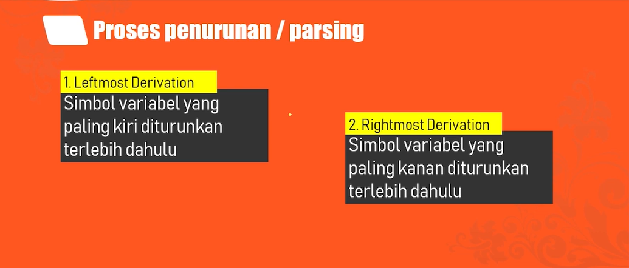
PARSING

Slide 13
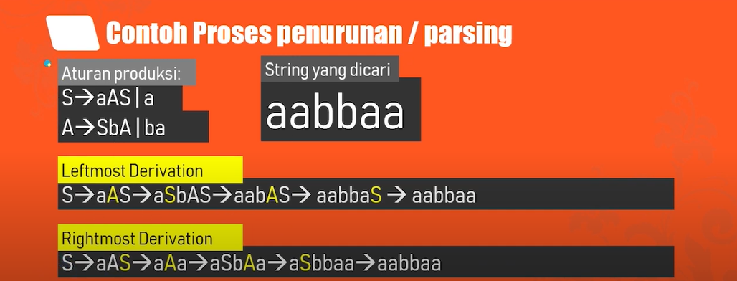
PARSING

Slide 14
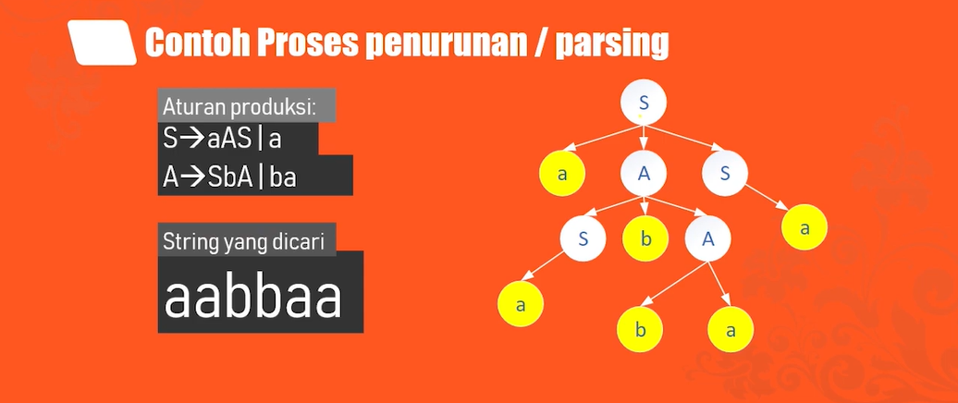
PARSING

Slide 15
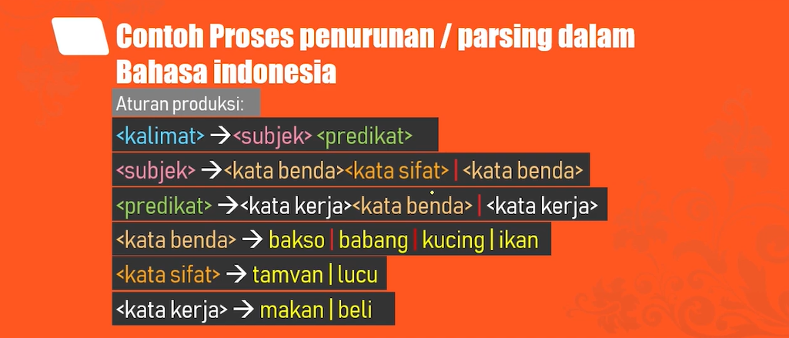
PARSING

Slide 16
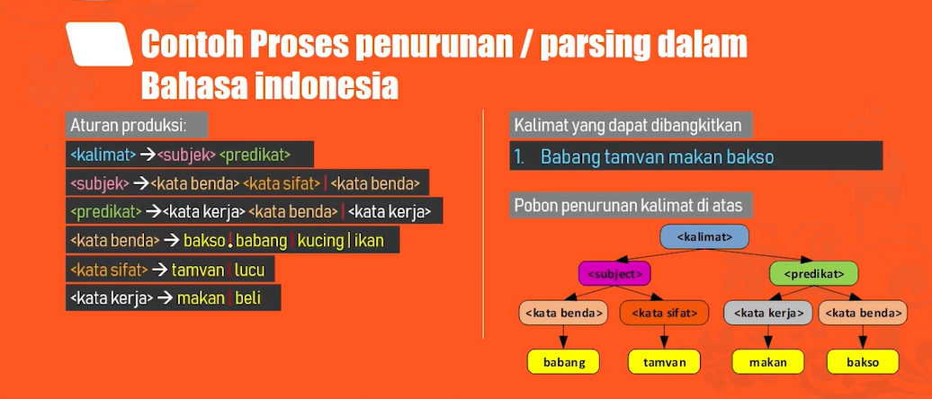
PARSING

Slide 17
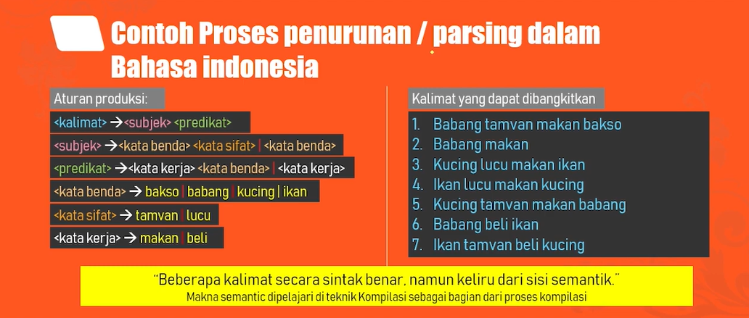
PARSING

Slide 18
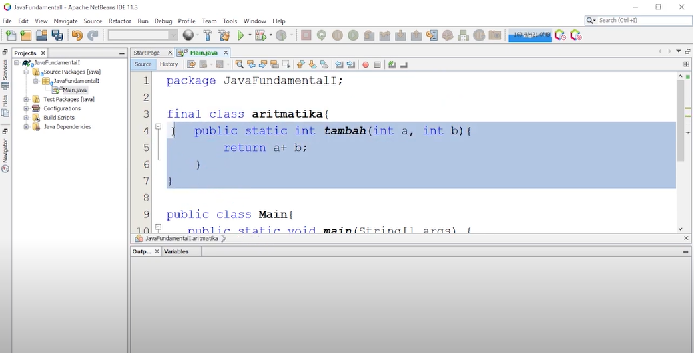
Contoh di Pemrograman

Slide 19
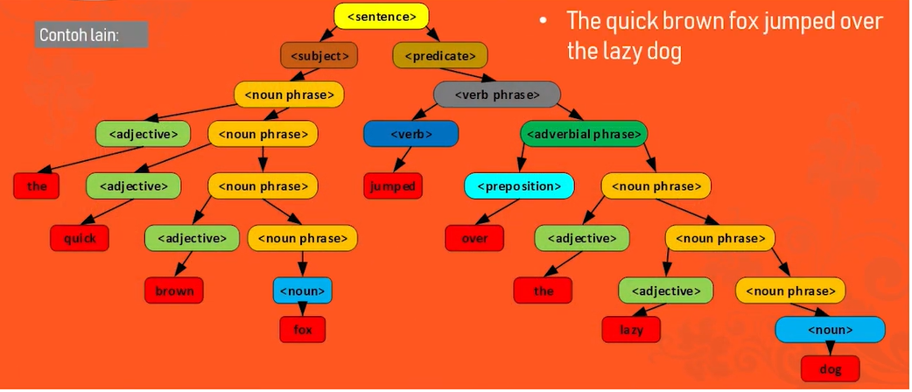
PARSING

Slide 20
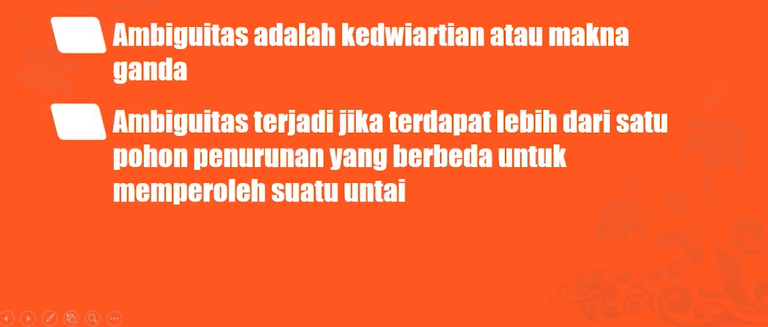
AMBIGUITAS

Slide 21
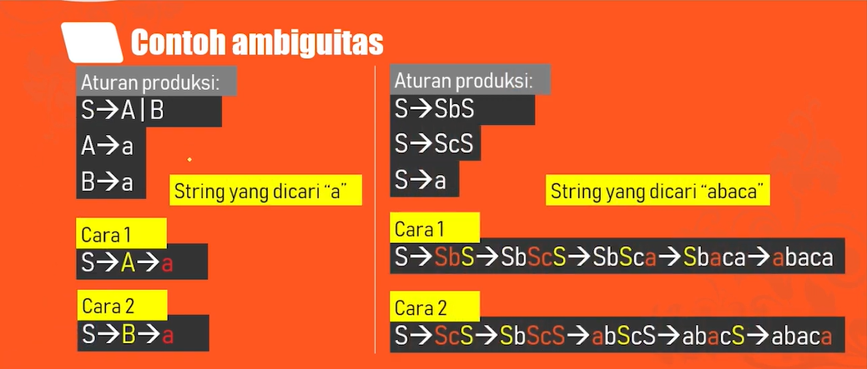
AMBIGUITAS

Slide 22
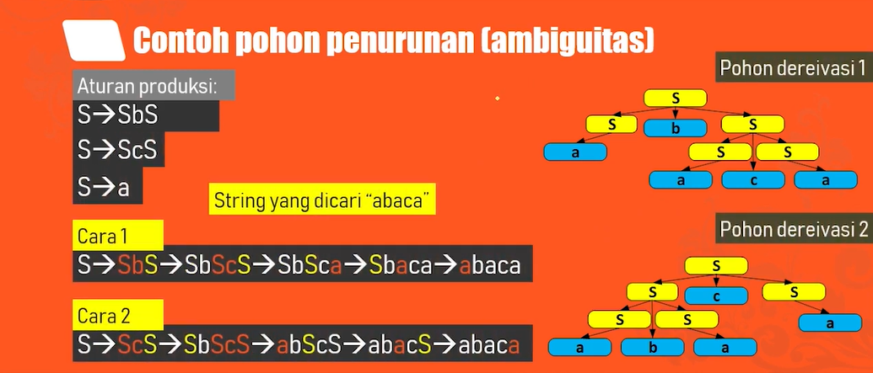
AMBIGUITAS

Slide 23
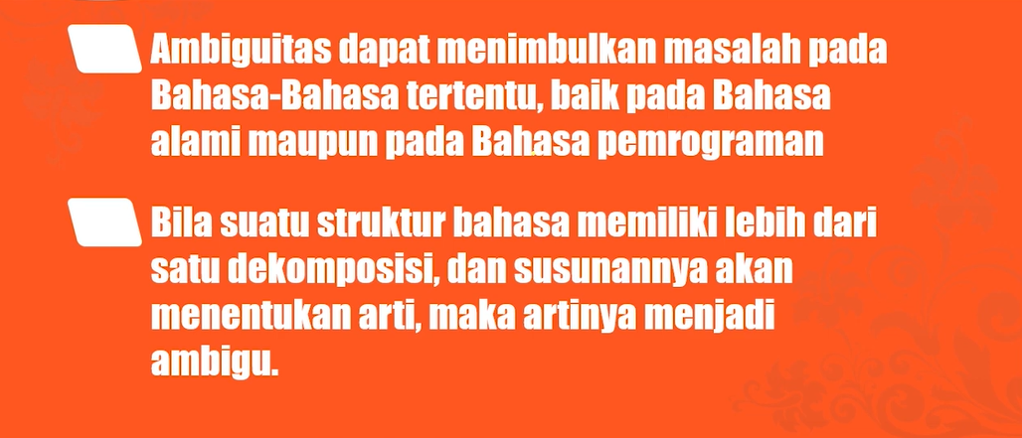
AMBIGUITAS

